Slide 1
Chapter 4
Expressions

Slide 2
Outline
Operator (binary, unary), Operand
arithmetic operators
relational operators
logical operators
assignment operators
increment and decrement operators
Associativity
Left associative/ right associative

Slide 3
Operators
C emphasizes expressions rather than statements.
Expressions are built from variables, constants, and operators.
C has a rich collection of operators, including
arithmetic operators
relational operators
logical operators
assignment operators
increment and decrement operators and many others

Slide 4
Arithmetic Operators
C provides five binary arithmetic operators:
+ addition
- subtraction
* multiplication
/ division
% remainder
An operator is binary if it has two operands.
There are also two unary arithmetic operators:
+ unary plus
- unary minus

Slide 5
#include <stdio.h>
int main()
{
int a=40,b=20, add, sub, mul, div, mod;
add = a+b;
sub = a-b;
mul = a*b;
div = a/b;
mod = a%b;
printf(“Addition of a, b is : %d\n”, add);
printf(“Subtraction of a, b is : %d\n”, sub);
printf(“Multiplication of a, b is : %d\n”, mul);
printf(“Division of a, b is : %d\n”, div);
printf(“Modulus of a, b is : %d\n”, mod);
}

Slide 6
(A + B) * C - (D - E) * (F + G)
Precedence?
Association?
Data Type?

Slide 7
Unary Arithmetic Operators
The unary operators require one operand:
i = +1;
j = -i;
The unary + operator does nothing. It’s used primarily to emphasize that a numeric constant is positive.

Slide 8
Binary Arithmetic Operators
The value of i % j is the remainder when i is divided by j.
10 % 3 has the value 1, and 12 % 4 has the value 0.
Binary arithmetic operators—with the exception of %—allow either integer or floating-point operands, with mixing allowed.
When int and float operands are mixed, the result has type float.
9 + 2.5f has the value 11.5, and 6.7f / 2 has the value 3.35.

Slide 9
The / and % Operators
The / and % operators require special care:
When both operands are integers, / “truncates” the result. The value of 1 / 2 is 0, not 0.5.
The % operator requires integer operands; if either operand is not an integer, the program won’t compile.
Using zero as the right operand of either / or % causes undefined behavior.
The behavior when / and % are used with negative operands is implementation-defined in C89.
In C99, the result of a division is always truncated toward zero and the value of i % j has the same sign as i.

Slide 10
Implementation-Defined Behavior
The C standard deliberately leaves parts of the language unspecified.
Leaving parts of the language unspecified reflects C’s emphasis on efficiency, which often means matching the way that hardware behaves.
It’s best to avoid writing programs that depend on implementation-defined behavior.

Slide 11
Operator Precedence
Does i + j * k mean “add i and j, then multiply the result by k” or “multiply j and k, then add i”?
One solution to this problem is to add parentheses, writing either (i + j) * k or i + (j * k).
If the parentheses are omitted, C uses operator precedence rules to determine the meaning of the expression.

Slide 12
Operator Precedence
The arithmetic operators have the following relative precedence:
Highest: + - (unary)
* / %
Lowest: + - (binary)
Examples:
i + j * k is equivalent to i + (j * k)
-i * -j is equivalent to (-i) * (-j)
+i + j / k is equivalent to (+i) + (j / k)

Slide 13
Operator Associativity
Associativity comes into play when an expression contains two or more operators with equal precedence.
An operator is said to be left associative if it groups from left to right.
The binary arithmetic operators (*, /, %, +, and -) are all left associative, so
i - j – k is equivalent to (i - j) - k
i * j / k is equivalent to (i * j) / k

Slide 14
Operator Associativity
An operator is right associative if it groups from right to left.
The unary arithmetic operators (+ and -) are both right associative, so
- + i is equivalent to -(+i)

Slide 15
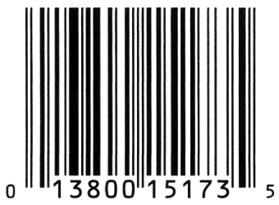
Program: Computing a UPC Check Digit
Most goods sold in U.S. and Canadian stores are marked with a Universal Product Code (UPC):
Meaning of the digits underneath the bar code:
First digit: Type of item
First group of five digits: Manufacturer
Second group of five digits: Product (including package size)
Final digit: Check digit, used to help identify an error in the preceding digits

Slide 16
Program: Computing a UPC Check Digit
How to compute the check digit:
Add the first+ third+ fifth+ seventh+ ninth+ eleventh digits.
Add the second+ fourth+ sixth+ eighth+ tenth digits.
Multiply the first sum by 3 and add it to the second sum.
Subtract 1 from the total.
Compute the remainder when the adjusted total is divided by 10.
Subtract the remainder from 9.

Slide 17
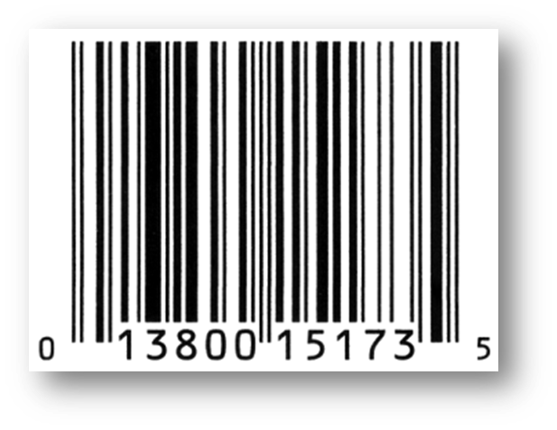
Program: Computing a UPC Check Digit
Example for UPC 0 13800 15173 5:
First sum: 0 + 3 + 0 + 1 + 1 + 3 = 8.
Second sum: 1 + 8 + 0 + 5 + 7 = 21.
Multiplying the first sum by 3 and adding the second yields 45.
Subtracting 1 gives 44.
Remainder upon dividing by 10 is 4.
Remainder is subtracted from 9.
Result is 5.

Slide 18
Program: Computing a UPC Check Digit
The upc.c program asks the user to enter the first 11 digits of a UPC, then displays the corresponding check digit:
Enter the first (single) digit: 0
Enter first group of five digits: 13800
Enter second group of five digits: 15173
Check digit: 5
The program reads each digit group as five one-digit numbers.
To read single digits, we’ll use scanf with the %1d conversion specification.

Slide 19
#include <stdio.h>
int main(void)
{
int d, i1, i2, i3, i4, i5, j1, j2, j3, j4, j5,
firstSum, secondSum, total;
printf("Enter the first (single) digit: ");
scanf("%1d", &d);
printf("Enter first group of five digits: ");
scanf("%1d%1d%1d%1d%1d", &i1, &i2, &i3, &i4, &i5);
printf("Enter second group of five digits: ");
scanf("%1d%1d%1d%1d%1d", &j1, &j2, &j3, &j4, &j5);
firstSum = d + i2 + i4 + j1 + j3 + j5;
secondSum = i1 + i3 + i5 + j2 + j4;
total = 3 * firstSum + secondSum;
printf("Check digit: %d\n", 9 - ((total - 1) % 10));
return 0;
}
upc.c

Slide 20
Assignment Operators
Simple assignment: used for storing a value into a variable
Compound assignment: used for updating a value already stored in a variable

Slide 21
Simple Assignment
The effect of the assignment v = e is to evaluate the expression e and copy its value into v.
e can be a constant, a variable, or a more complicated expression:
i = 5; /* i is now 5 */
j = i; /* j is now 5 */
k = 10 * i + j; /* k is now 55 */

Slide 22
Simple Assignment
If v and e don’t have the same type, then the value of e is converted to the type of v as the assignment takes place:
int i;
float f;
i = 72.99f; /* i is now 72 */
f = 136; /* f is now 136.0 */

Slide 23
Simple Assignment
In many programming languages, assignment is a statement; in C, however, assignment is an operator, just like +.
The value of an assignment v = e is the value of v after the assignment.
The value of i = 72.99f is 72 (not 72.99).

Slide 24
Side Effects
An operators that modifies one of its operands is said to have a side effect.
The simple assignment operator has a side effect: it modifies its left operand.
Evaluating the expression i = 0 produces the result 0 and—as a side effect—assigns 0 to i.

Slide 25
Side Effects
Since assignment is an operator, several assignments can be chained together:
i = j = k = 0;
The = operator is right associative, so this assignment is equivalent to
i = (j = (k = 0));

Slide 26
Side Effects
Watch out for unexpected results in chained assignments as a result of type conversion:
int i;
float f;
f = i = 33.3f;
i is assigned the value 33, then f is assigned 33.0 (not 33.3).

Slide 27
Side Effects
An assignment of the form v = e is allowed wherever a value of type v would be permitted:
i = 1;
k = 1 + (j = i);
printf("%d %d %d\n", i, j, k);
/* prints "1 1 2" */
“Embedded assignments” can make programs hard to read.
They can also be a source of subtle bugs.

Slide 28
Lvalues
The assignment operator requires an lvalue as its left operand.
An lvalue represents an object stored in computer memory, not a constant or the result of a computation.
Variables are lvalues; expressions such as 10 or 2 * i are not.

Slide 29
Lvalues
Since the assignment operator requires an lvalue as its left operand, it’s illegal to put any other kind of expression on the left side of an assignment expression:
12 = i; /*** WRONG ***/
i + j = 0; /*** WRONG ***/
-i = j; /*** WRONG ***/
The compiler will produce an error message such as “invalid lvalue in assignment.”

Slide 30
Compound Assignment
Assignments that use the old value of a variable to compute its new value are common.
Example:
i = i + 2;
Using the += compound assignment operator, we simply write:
i += 2; /* same as i = i + 2; */

Slide 31
Compound Assignment
There are nine other compound assignment operators, including the following:
-= *= /= %=
All compound assignment operators work in much the same way:
v += e adds v to e (e means expression), storing the result in v
v -= e subtracts e from v, storing the result in v
v *= e multiplies v by e, storing the result in v
v /= e divides v by e, storing the result in v
v %= e computes the remainder when v is divided by e, storing the result in v

Slide 32
Compound Assignment
v += e isn’t “equivalent” to v = v + e.
One problem is operator precedence: i *= j + k isn’t the same as i = i * j + k.
There are also rare cases in which v += e differs from v = v + e because v itself has a side effect.
Similar remarks apply to the other compound assignment operators.

Slide 33
Compound Assignment
When using the compound assignment operators, be careful not to switch the two characters that make up the operator.
Although i =+ j will compile, it is equivalent to i = (+j), which merely copies the value of j into i.

Slide 34
Increment and Decrement Operators
Two of the most common operations on a variable are “incrementing” (adding 1) and “decrementing” (subtracting 1):
i = i + 1;
j = j - 1;
Incrementing and decrementing can be done using the compound assignment operators:
i += 1;
j -= 1;

Slide 35
Increment and Decrement Operators
C provides special ++ (increment) and -- (decrement) operators.
The ++ operator adds 1 to its operand. The -- operator subtracts 1.
The increment and decrement operators are tricky to use:
They can be used as prefix operators (++i and –-i) or postfix operators (i++ and i--).
They have side effects: they modify the values of their operands.

Slide 36
Increment and Decrement Operators
Evaluating the expression ++i (a “pre-increment”) yields i + 1 and—as a side effect—increments i:
i = 1;
printf("i is %d\n", ++i); /* prints "i is 2" */
printf("i is %d\n", i); /* prints "i is 2" */
Evaluating the expression i++ (a “post-increment”) produces the result i, but causes i to be incremented afterwards:
i = 1;
printf("i is %d\n", i++); /* prints "i is 1" */
printf("i is %d\n", i); /* prints "i is 2" */

Slide 37
Increment and Decrement Operators
++i means “increment i immediately,” while i++ means “use the old value of i for now, but increment i later.”
How much later? The C standard doesn’t specify a precise time, but it’s safe to assume that i will be incremented before the next statement is executed.

Slide 38
Increment and Decrement Operators
The -- operator has similar properties:
i = 1;
printf("i is %d\n", --i); /* prints "i is 0" */
printf("i is %d\n", i); /* prints "i is 0" */
i = 1;
printf("i is %d\n", i--); /* prints "i is 1" */
printf("i is %d\n", i); /* prints "i is 0" */

Slide 39
Increment and Decrement Operators
When ++ or -- is used more than once in the same expression, the result can often be hard to understand.
Example:
i = 1;
j = 2;
k = ++i + j++;
The last statement is equivalent to
i = i + 1;
k = i + j;
j = j + 1;
The final values of i, j, and k are 2, 3, and 4, respectively.

Slide 40
Increment and Decrement Operators
In contrast, executing the statements
i = 1;
j = 2;
k = i++ + j++;
will give i, j, and k the values 2, 3, and 3, respectively.

Slide 41
Expression Evaluation
Table of operators discussed so far:
Precedence Name Symbol(s) Associativity
1 increment (postfix) ++ left
decrement (postfix) --
2 increment (prefix) ++ right
decrement (prefix) --
unary plus +
unary minus -
3 multiplicative * / % left
4 additive + - left
5 assignment = *= /= %= += -= right

Slide 42
Expression Evaluation
The table can be used to add parentheses to an expression that lacks them.
Starting with the operator with highest precedence, put parentheses around the operator and its operands.
Example:
a = b += c++ - d + --e / -f
Precedence
level
a = b += (c++) - d + --e / -f 1
a = b += (c++) - d + (--e) / (-f) 2
a = b += (c++) - d + ((--e) / (-f)) 3
a = b += (((c++) - d) + ((--e) / (-f))) 4
(a = (b += (((c++) - d) + ((--e) / (-f))))) 5
int a, b=1, c = 10, d = 10, e = 10, f = 3;
a = b += c++ - d + --e / -f;

Slide 43
Expression Evaluation
Example:
int a, b=1, c = 10, d = 10, e = 10, f = 3;
a = b += c++ - d + --e / -f;
a = -2
b= -2
c= 11
d= 10
e= 9
f= 3

Slide 44
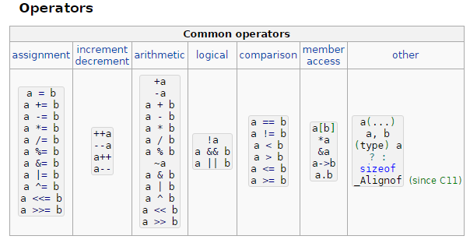

Slide 45
Order of Subexpression Evaluation
The value of an expression may depend on the order in which its subexpressions are evaluated.
C doesn’t define the order in which subexpressions are evaluated (with the exception of subexpressions involving the logical and, logical or, conditional, and comma operators).
In the expression (a + b) * (c - d) we don’t know whether (a + b) will be evaluated before (c - d).

Slide 46
Order of Subexpression Evaluation
Most expressions have the same value regardless of the order in which their subexpressions are evaluated.
However, this may not be true when a subexpression modifies one of its operands:
a = 5;
c = (b = a + 2) - (a = 1);
The effect of executing the second statement is undefined.

Slide 47
Order of Subexpression Evaluation
Avoid writing expressions that access the value of a variable and also modify the variable elsewhere in the expression.
Some compilers may produce a warning message such as “operation on ‘a’ may be undefined” when they encounter such an expression.

Slide 48
Order of Subexpression Evaluation
To prevent problems, it’s a good idea to avoid using the assignment operators in subexpressions.
Instead, use a series of separate assignments:
a = 5;
b = a + 2;
a = 1;
c = b - a;
The value of c will always be 6.
c = (b = a + 2) - (a = 1);

Slide 49
Order of Subexpression Evaluation
Besides the assignment operators, the only operators that modify their operands are increment and decrement.
When using these operators, be careful that an expression doesn’t depend on a particular order of evaluation.

Slide 50
Order of Subexpression Evaluation
Example:
i = 2;
j = i * i++;
It’s natural to assume that j is assigned 4. However, j could just as well be assigned 6 instead:
The second operand (the original value of i) is fetched, then i is incremented.
The first operand (the new value of i) is fetched.
The new and old values of i are multiplied, yielding 6.

Slide 51
Undefined Behavior
Statements such as c = (b = a + 2) - (a = 1); and j = i * i++; cause undefined behavior.
Possible effects of undefined behavior:
The program may behave differently when compiled with different compilers.
The program may not compile in the first place.
If it compiles it may not run.
If it does run, the program may crash, behave erratically, or produce meaningless results.
Undefined behavior should be avoided.

Slide 52
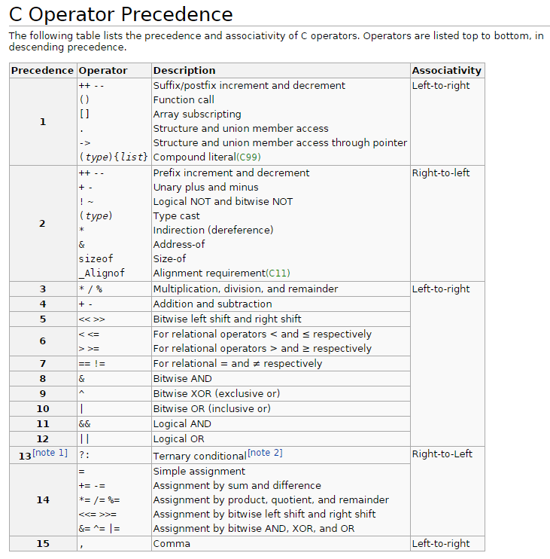

Slide 53
Expression Statements
C has the unusual rule that any expression can be used as a statement.
Example:
++i;
i is first incremented, then the new value of i is fetched but then discarded.

Slide 54
Expression Statements
Since its value is discarded, there’s little point in using an expression as a statement unless the expression has a side effect:
i = 1; /* useful */
i--; /* useful */
i * j - 1; /* not useful */

Slide 55
Expression Statements
A slip of the finger can easily create a “do-nothing” expression statement.
For example, instead of entering
i = j;
we might accidentally type
i + j;
Some compilers can detect meaningless expression statements; you’ll get a warning such as “statement with no effect.”

